Slide 1
City of Marysville General Plan Update + Specific Plan
March 2022

Slide 2
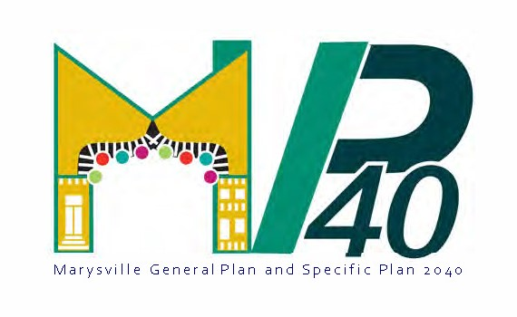
Overview
Purpose and focus
Overview of the process
Public engagement
Key Issues
Vision and Guiding Principles
Stop me for Questions along the way!
Notes:
Purpose and focus of the General Plan update and Specific Plan
Overview of the planning process
Opportunities for public engagement and input
Vision and Guiding Principles
Key Issues
Next Steps
Q&A

Slide 3
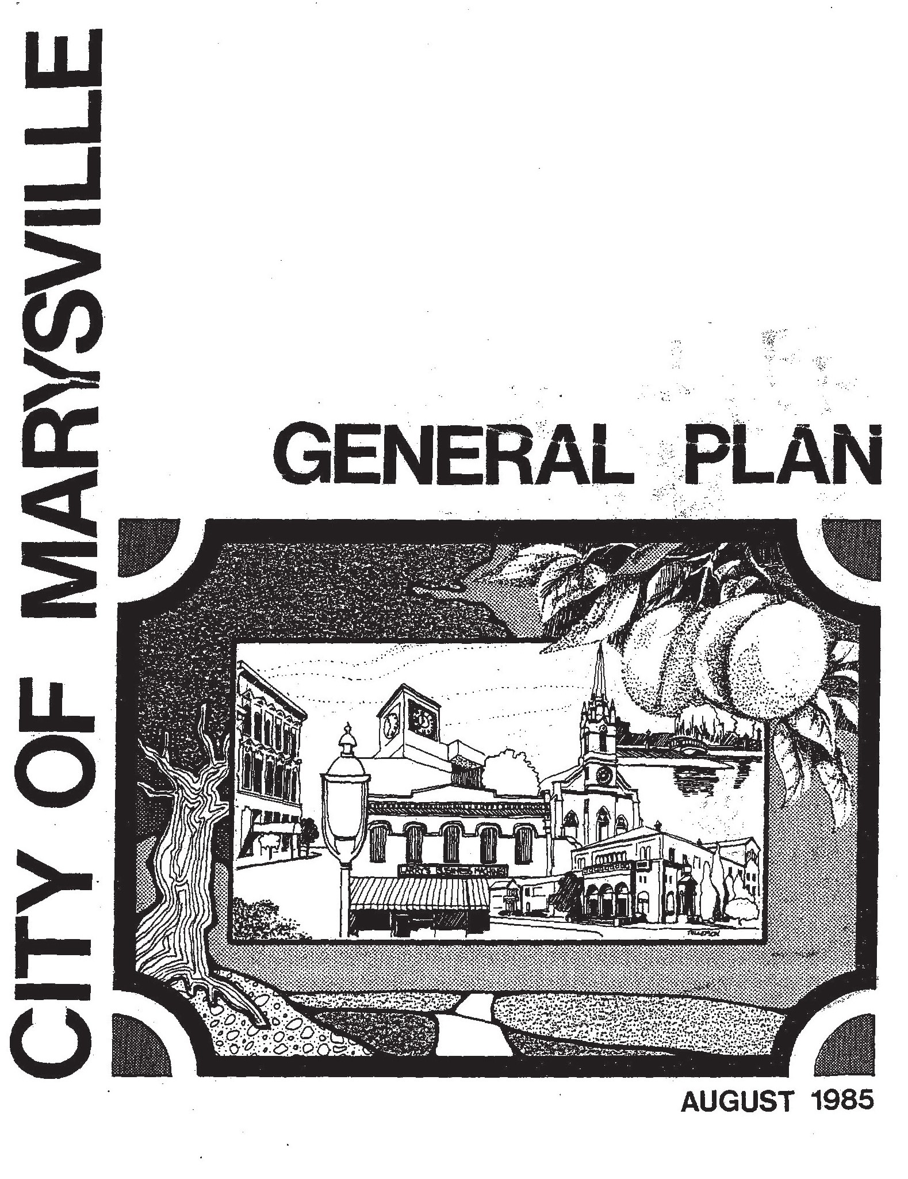
Purpose and Focus for the General Plan Update
Economic and fiscal sustainability
Expanding options for transportation
Expand housing opportunities
State law compliance
Streamline future development
2040 planning horizon
Notes:
The General Plan Update will focus on:
Policies to ensure economic/fiscal sustainability
Transportation needs
Public/environmental health
Housing
Ensure compliance with new State laws
Policy recommendations will use best and updated planning practices
All main phases will offer decision maker, stakeholder, and public input
Streamline future development
Identify improvements in the City that are most important, and can be the subject of future grant applications
2040 planning horizon

Slide 4
Purpose and Focus for the Specific Plan
SACOG grant
Facilitate housing production
Promote infill
Encourage transit, bicycling, and walking
Enhance community assets
Inclusive engagement
Address the SACOG Green Zone
Marysville Green Zone
Notes:
The Specific Plan will focus on the concepts outlined in the City’s grant application to SACOG through the REAP Grant:
Facilitating housing production
Supporting infill development and reinvestment, particularly in the Downtown area
Promoting transit, bicycling, and walking to reach destinations
Enhancing community assets
Engaging the public, including disadvantaged communities
Address the SACOG Green Zone within the City – the railroad on the east, the Yuba River to the South, the railroad and Willow Street to the west, and Ellis Lake on the north

Slide 5
General Plan Update Phases
Project Initiation
Intelligence Gathering
Vision, Guiding Principles, and Alternatives
Plan Development and Environmental Review
Certification and Adoption
Notes:
The planning process has five main phases:
Project initiation
Intelligence gathering
Vision, guiding principles, and alternatives
Plan development and environmental review
Certification and adoption

Slide 6
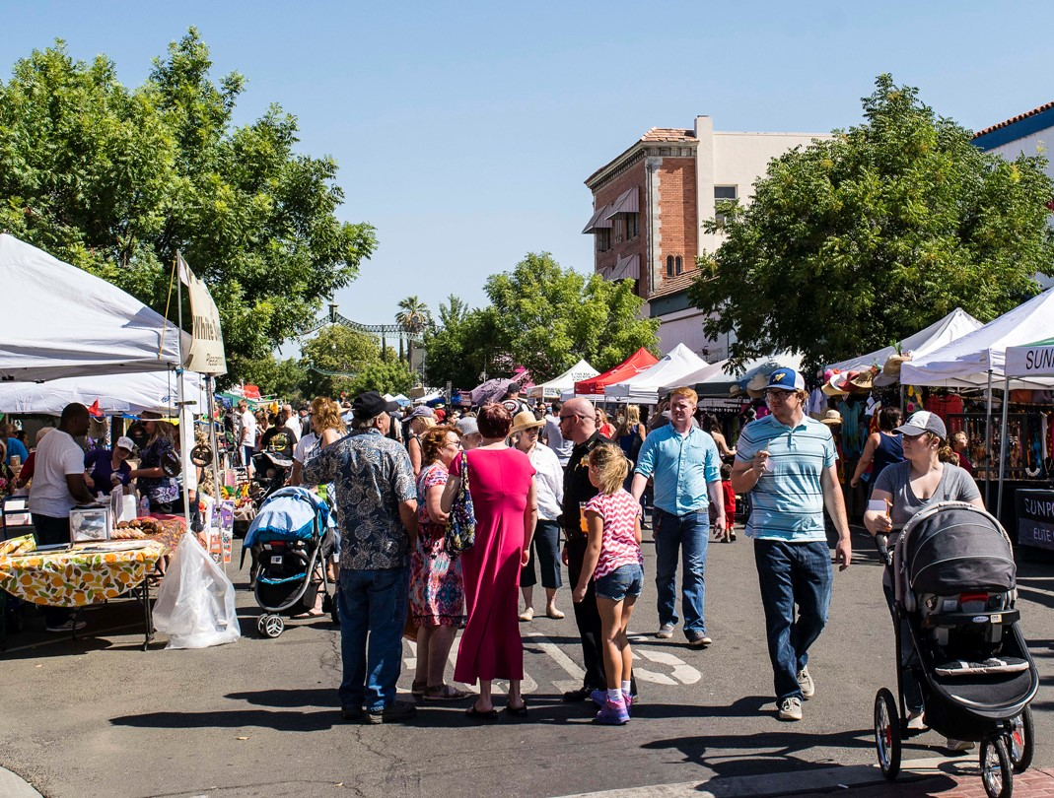
Project Initiation
Confirm project goals
Roles
Responsibilities
Schedule
Notes:
Confirm project goals
Roles
Responsibilities
Schedule
Project goals
Approach
Roles
Schedule
Communication protocols
New development areas to potentially include in General Plan
Optional elements in General Plan
Traffic level of service analysis
Public engagement strategy (online, in-person, mix of both)
Meeting with multiple City staff members to discuss areas of focus, etc.

Slide 7
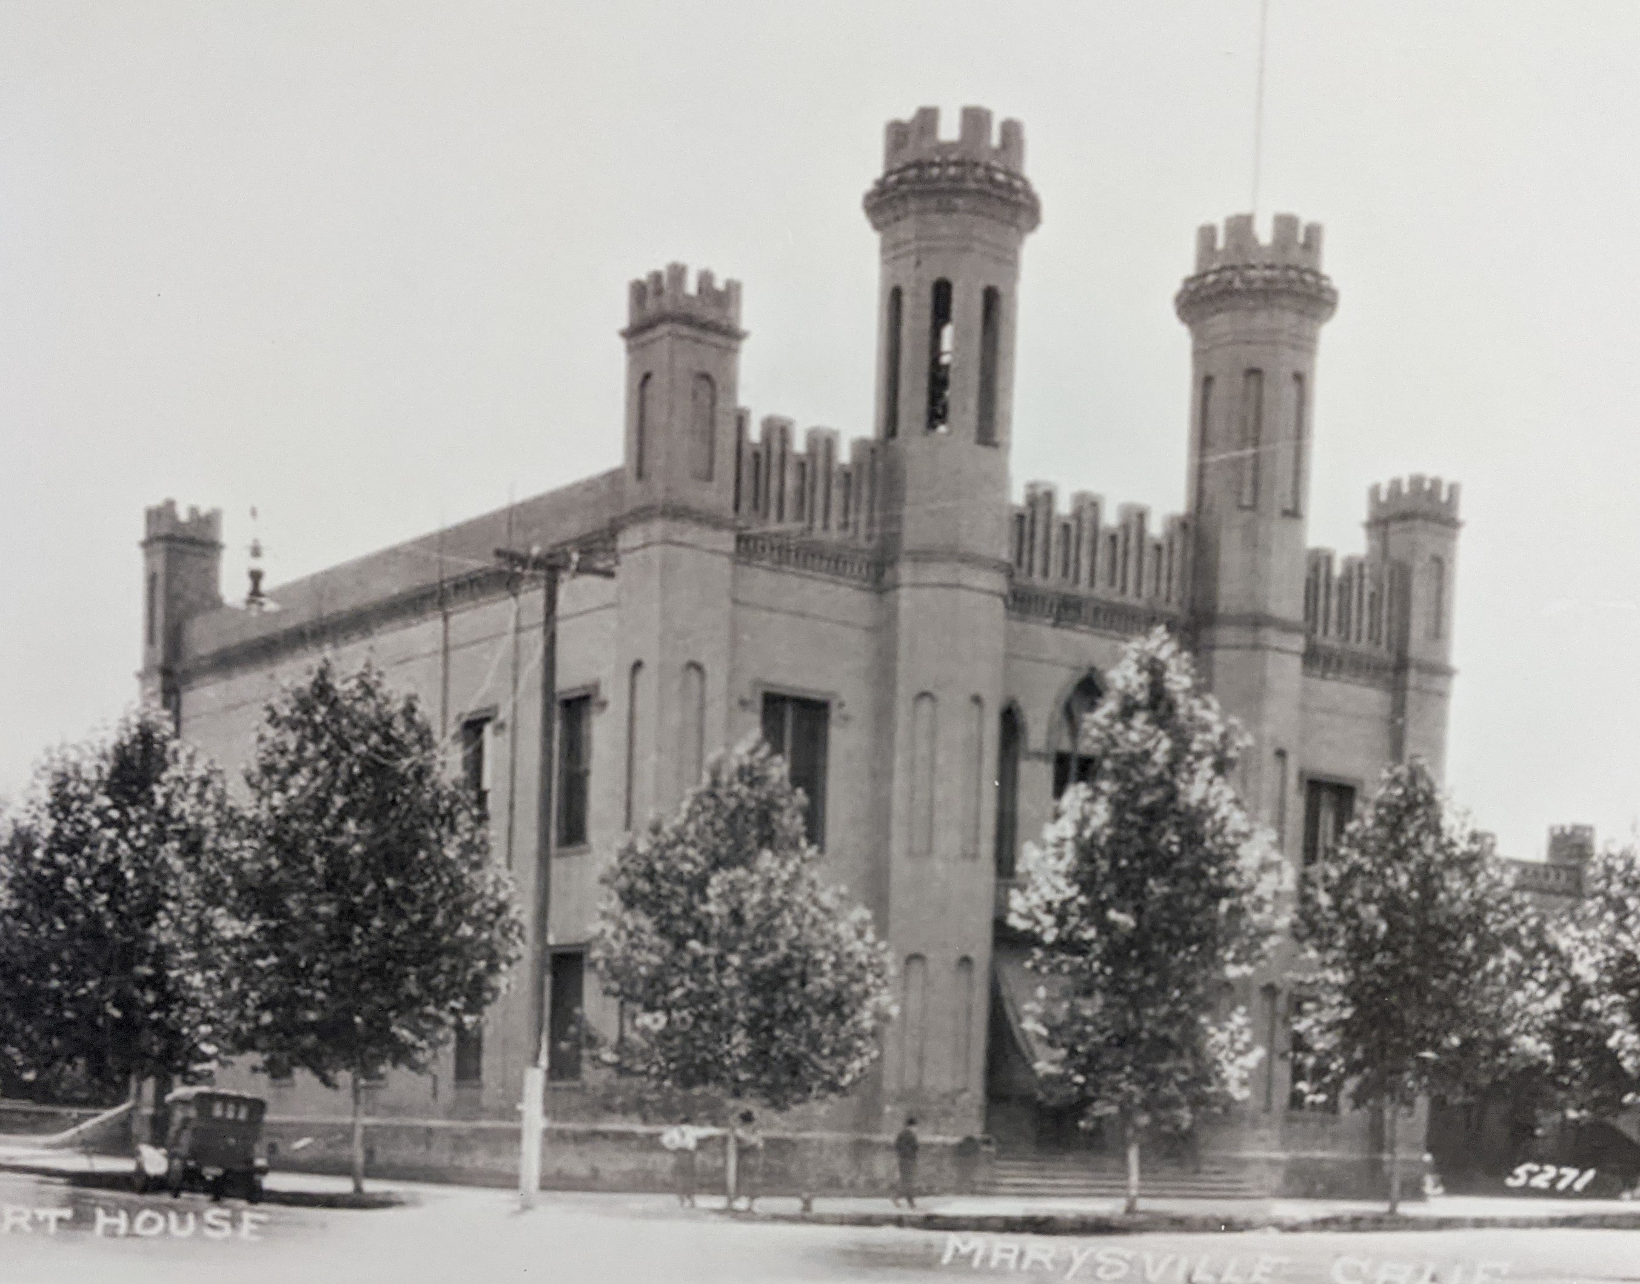
Intelligence Gathering
Planning
Infrastructure
Local economy
Historic resources
Natural resources
Notes:
Review of existing planning documents and reports related to planning, environmental review, transportation, hazardous materials, infrastructure (e.g., master plans), market and economics, housing, fiscal and other related topics
General Plan Background Report will highlight important existing conditions and trends that should drive the development of the General Plan update, and will address:
Land use
Local economy
Natural environment
Transportation
Public safety
Housing
Synthesize key issues, trends, and opportunities to help understand what policy changes are needed.

Slide 8
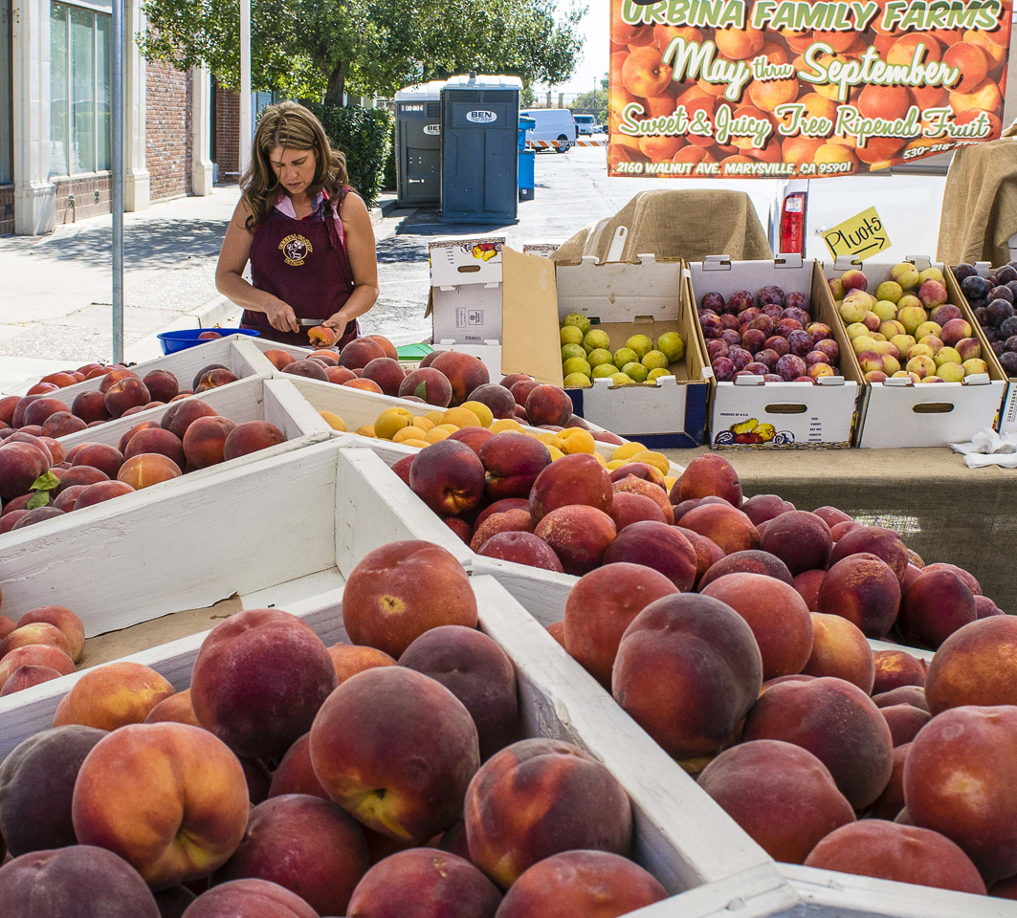
Public Engagement
Key issues
Vision and guiding principles
Alternatives
Draft Plan
General Plan Advisory Committee
Planned first meeting: April 13th
Notes:
For each main phase of the General Plan update, we envision public engagement and input in three ways:
A study session with the Planning Commission or City Council where the general public is encouraged to attend and participate
An in-person, informal meeting with the General Plan Update Committee which would be open to the public
Broad public input generated by existing City social media channels, presence on the City’s website, and email messages sent out to a General Plan email contact list (City contacts, participants in the Housing Element update, and augmented during the General Plan update process)
We will gather input in each phase, including:
Key issues
Vision and guiding principles
Alternatives
Draft Plan
And engage a General Plan Update Committee that is diverse and representative
Local stakeholders, agency representatives, local organizations, business community

Slide 9
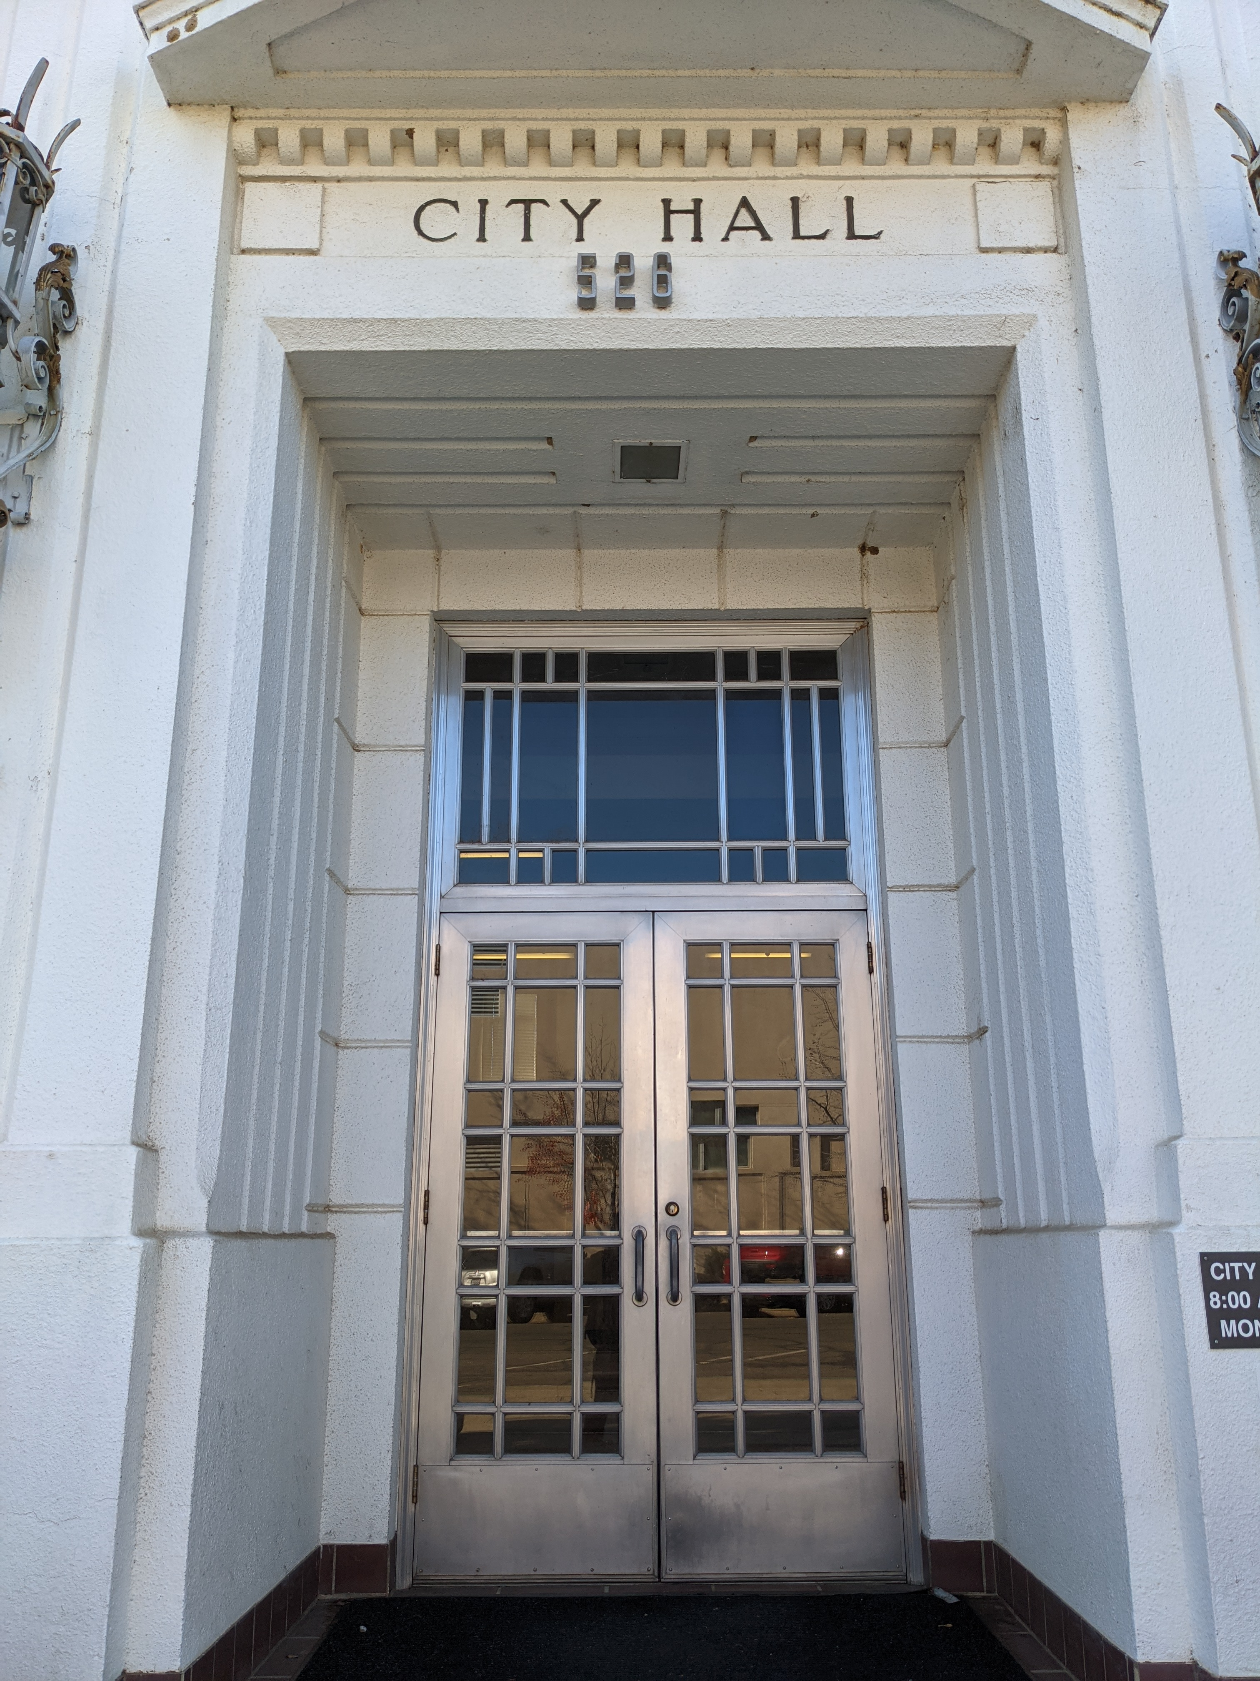
Vision + Guiding Principles + Alternatives
Vision Statement for 2040
Guiding Principles
High-level consensus
Alternatives
Notes:
Develop the Vision statement for the future of Marysville,
Vision is a long-range vision of what the successful City of Marysville will look like in 2040 and beyond, “big picture” ideas
Guiding Principles are essentially Shared Values
Guiding Principles are the Agreed-on “rules” for creating the General Plan
Guiding Principles will be created to support the Vision statement
The Vision and Guiding Principles statement will guide the Alternatives and development of the General Plan
Input on Vision and Guiding Principles (Committee and general public → Planning Commission/City Council
The Vision and Guiding Principles are important for establishing early on agreement on high-level issues.
Alternatives are conceptual options for land use and transportation, can address other topics
Intentional contrast among possible pathways
Identify preferred alternative to use for preparing the draft plans
High-level analysis of the fiscal, economic, land use, transportation, and environmental implications of each alternative
Used to facilitate discussion among City staff and key stakeholders to identify key issues facing the City
Planning Commission is to provide a recommendation of the preferred General Plan alternative after input from the public, Committee, and decision makers. City Council to provide ultimate direction

Slide 10
Plan Development and Environmental Review
Policy Recommendations
Draft General Plan
Comprehensive Update
Public Review of Draft
Environmental Impact Report
Notes:
To start:
Policy recommendations will be produced from reviewing and considering
Key findings from our intelligence
Input on each phase
Comprehensive General Plan update
Address all relevant planning topics
With the exception of Housing, which was just updated, and likely few changes to Safety
Draft General Plan
Including Environmental Justice Element that promotes fair treatment of all people regarding environmental health
Environmental Impact Report (EIR) for California Environmental Quality Act (CEQA) compliance for the plans

Slide 11
Certification and Adoption
Planning Commission recommendation
City Council action
Notes:
Hearings

Slide 12
Specific Plan
Project Initiation
SPECIFIC PLAN AREA PROFILE
Key strengths, opportunities, challenges, and trends
Confirmation of specific plan approach
Key Destinations and multi-modal pathways
Development standards and land use program
Planning-level infrastructure improvements and financing plane
Specific Plan
CEQA ANALYSIS AND DOCUMENTATION

Slide 13
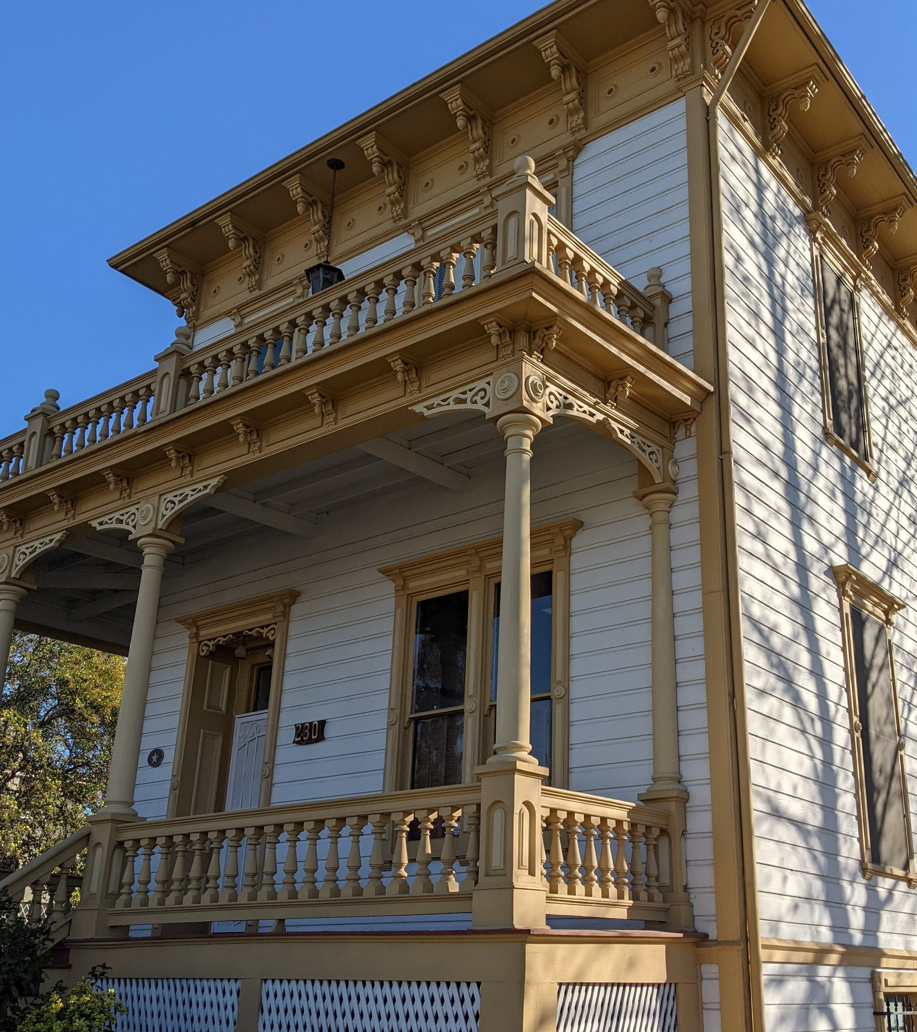
Project Initiation
Collect and review information
Prepare historic resources inventory for Marysville Commercial District
Identify issues and opportunities
Notes:
Coordinate with the City to identify, collect, and review studies that relate to the Specific Plan (data provided by the City and from other public agencies). This will include information for base maps, infrastructure master plans, etc.
Tour of the Specific Plan Area to review physical conditions and characteristics and discuss known issues and opportunities

Slide 14
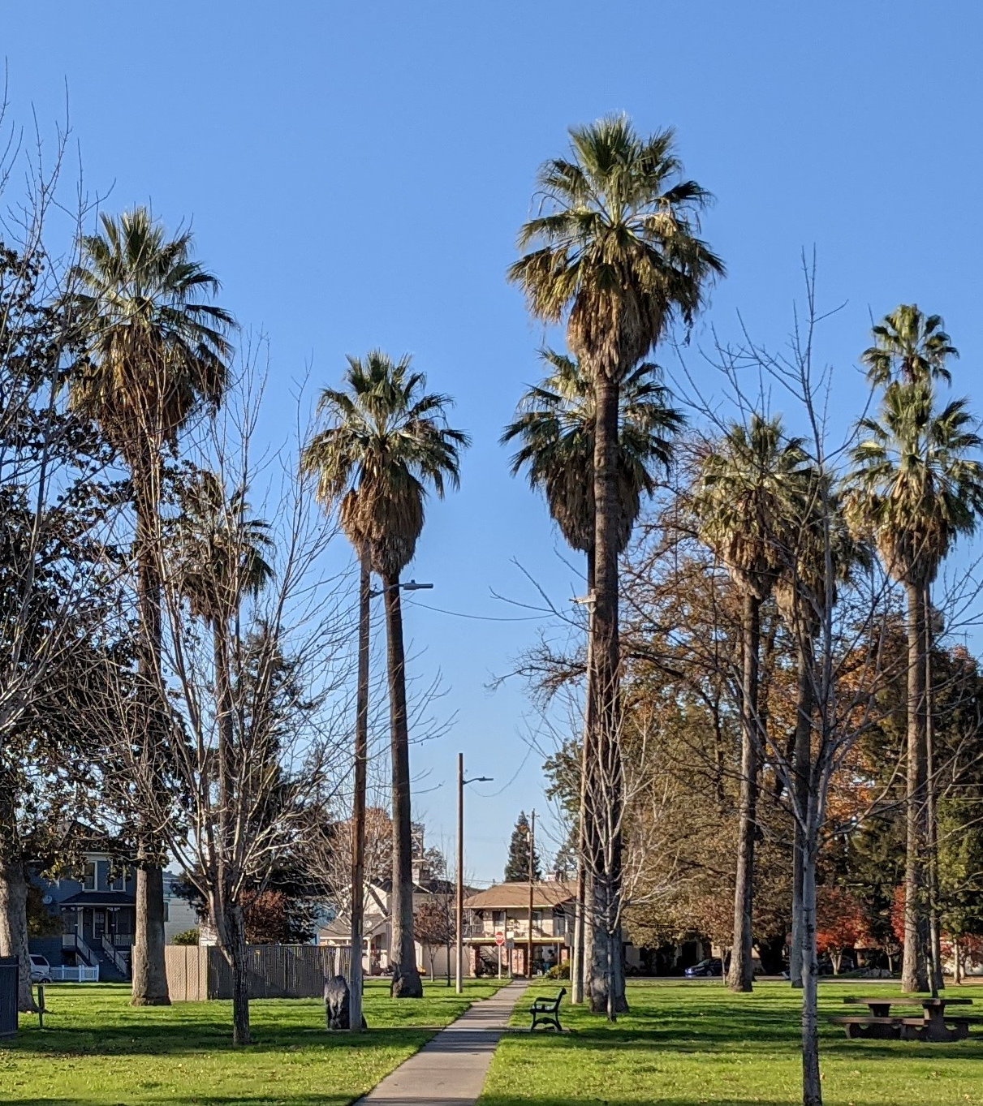
Specific Plan Area Profile
Establish baseline conditions
Demographic, land use, economic, and transportation characteristics
Notes:
Establish baseline conditions within the Specific Plan Area that would highlight demographic, land use, economic, and transportation characteristics
One-day reconnaissance level survey will be completed to update City’s inventory of contributing resources to the Marysville Historic Commercial District and, if necessary, update the City’s finding of eligibility

Slide 15
Key Strengths, Opportunities, Challenges, and Trends
Through a survey
Through a discussion with the General Plan Advisory Committee
Notes:
Outreach to give stakeholders, decision makers, and the public an opportunity for their input, through a survey to be presented verbally at Planning Commission or City Council study session, electronically via City’s website, and through email contact list
Conduct stakeholder interviews (telephone/video chat interviews) and assist the City with two stakeholder meetings
Survey to be distributed to stakeholders in the area, including
individuals interested in historic preservation,
people and organizations that participated in recent planning efforts,
agencies and organizations with an interest in the area,
property owners and interested developers,
affordable housing and social service organizations,
and other potentially interested parties, specifically engaging with those representing disadvantaged communities
Stakeholder interviews are expected to include Rideout Regional Medical Center, local business owners, potentially representatives from other relatively large employers, such as Yuba County, the California Department of Transportation, the Marysville Joint Unified School District, and Yuba County Water Agency.

Slide 16
Confirmation of Specific Plan Approach
Focus on critical issues identified in the SACOG grant application
Foundational ideas for allowable land use, density, and design standards, transportation, and open space
Promote the ‘shelf life’ of the Specific Plan
Notes:
Focus on critical issues identified in the SACOG grant application
Foundational ideas for allowable land use, density, and design standards, and what the Specific Plan should provide by way of framework for transportation and open space concepts
We assume that the Specific Plan would not include detailed infrastructure master planning, but should develop a consensus of what infrastructure recommendations would be provided

Slide 17
Key Destinations and Multi-Modal Pathways
Identify gaps in active transportation
Improvements to multi-modal access
Key destinations
Informed by public input and the General Plan Advisory Committee
Notes:
Existing vehicular, transit, bicycle, and pedestrian connections will be reviewed
Collaborate with City staff to identify conceptual strategies to improve multi-modal connectivity between existing and future residential areas and important destinations (employment, parks and open space, schools, retail/commercial/public services)
Online survey to invite input from the public and key stakeholders

Slide 18
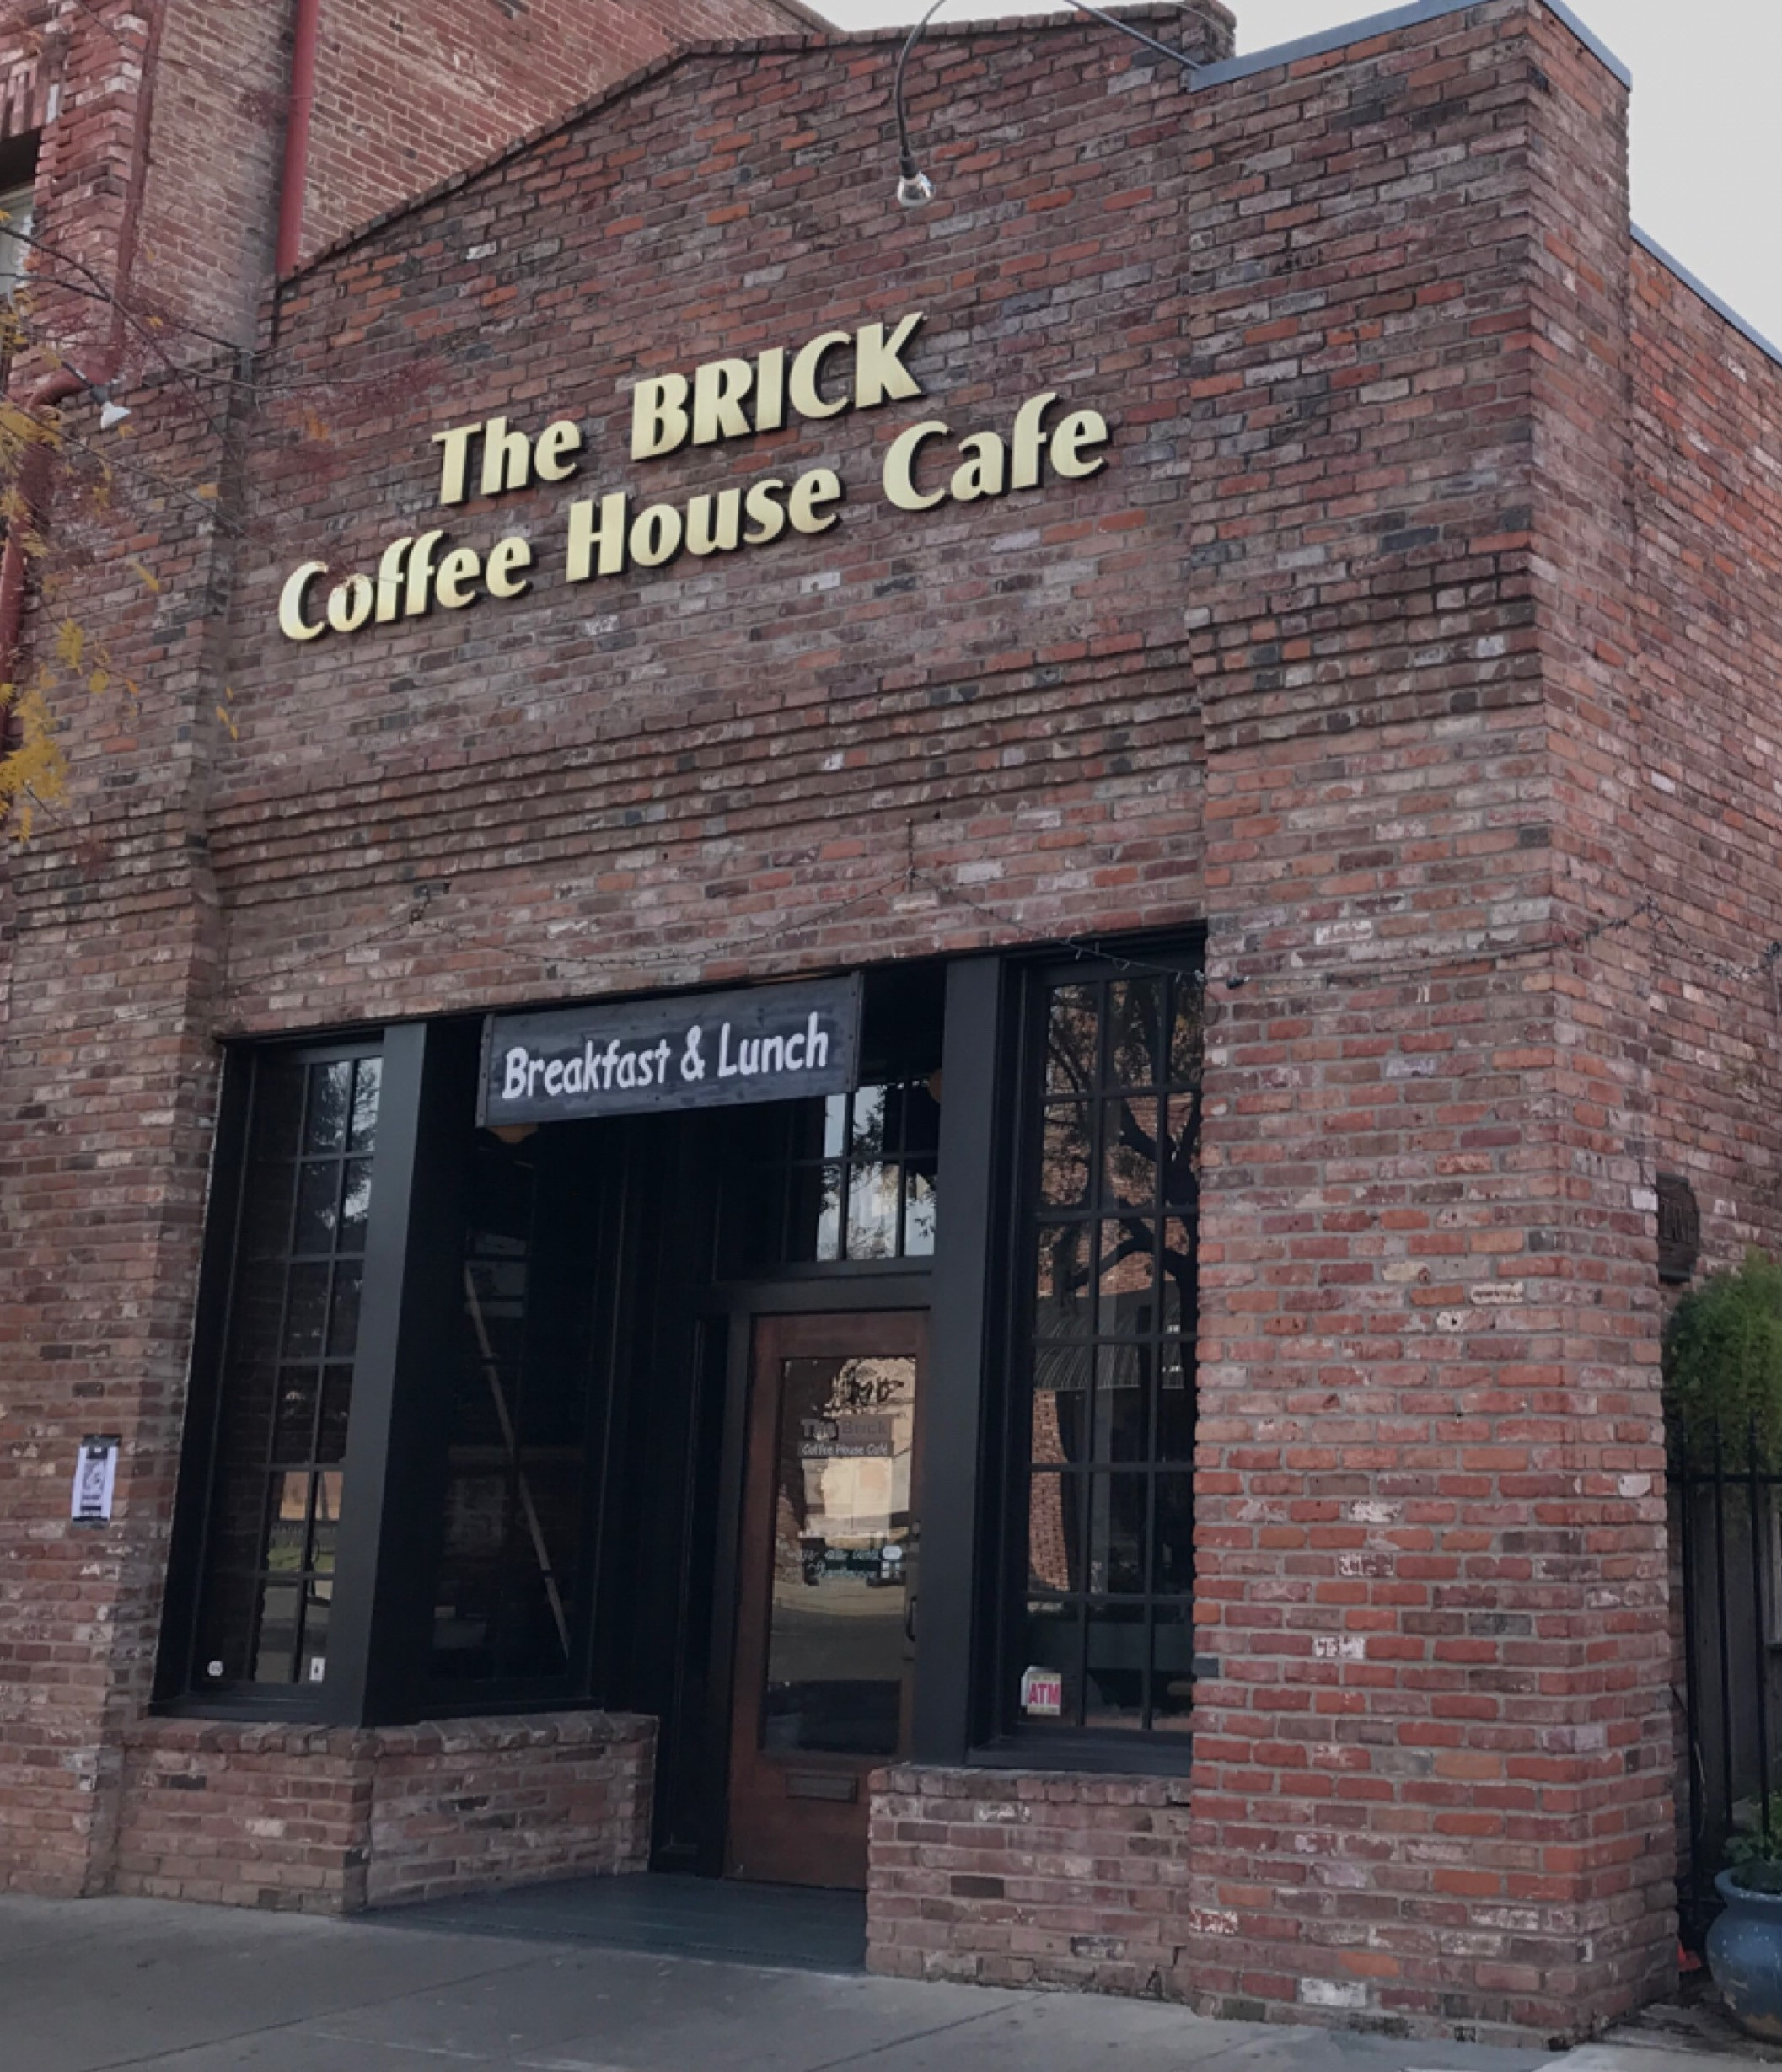
Development Standards and Land Use Program
Development standards
Land use programming
Areas of change
Public improvements
Notes:
Provide recommended design standards like public streetscape and private development, including street trees and other landscaping, pedestrian and bicycle infrastructure, land use compatibility, parks and open space, signage, etc.
Identify candidate properties where land use change can be anticipated under this Specific Plan
Land use change assumptions will inform the reporting designed to streamline development consistent with these assumptions

Slide 19
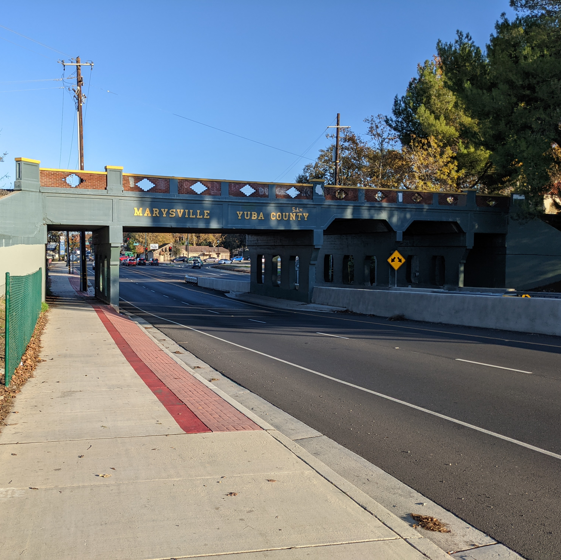
Infrastructure Improvements + Financing
Conceptual improvements
Water, sewer, drainage, transportation
Funding sources
Funding strategy
Notes:
Summarize conceptual infrastructure improvements needed to serve anticipated under the Specific Plan and conceptual cost estimates
Identify potential funding sources and overall funding strategy
Goal is to help attract development and improve the quality of life, and support future grant applications to fund these improvements
Infrastructure improvements for backbone water, wastewater, drainage conveyance, and transportation improvements
Potentially feasible funding sources could include existing tools and mechanisms, public land-secured debt financing mechanisms, regional, state, and federal funding, area-specific development impact fees, special assessments and taxes, and private contributions and exactions

Slide 20
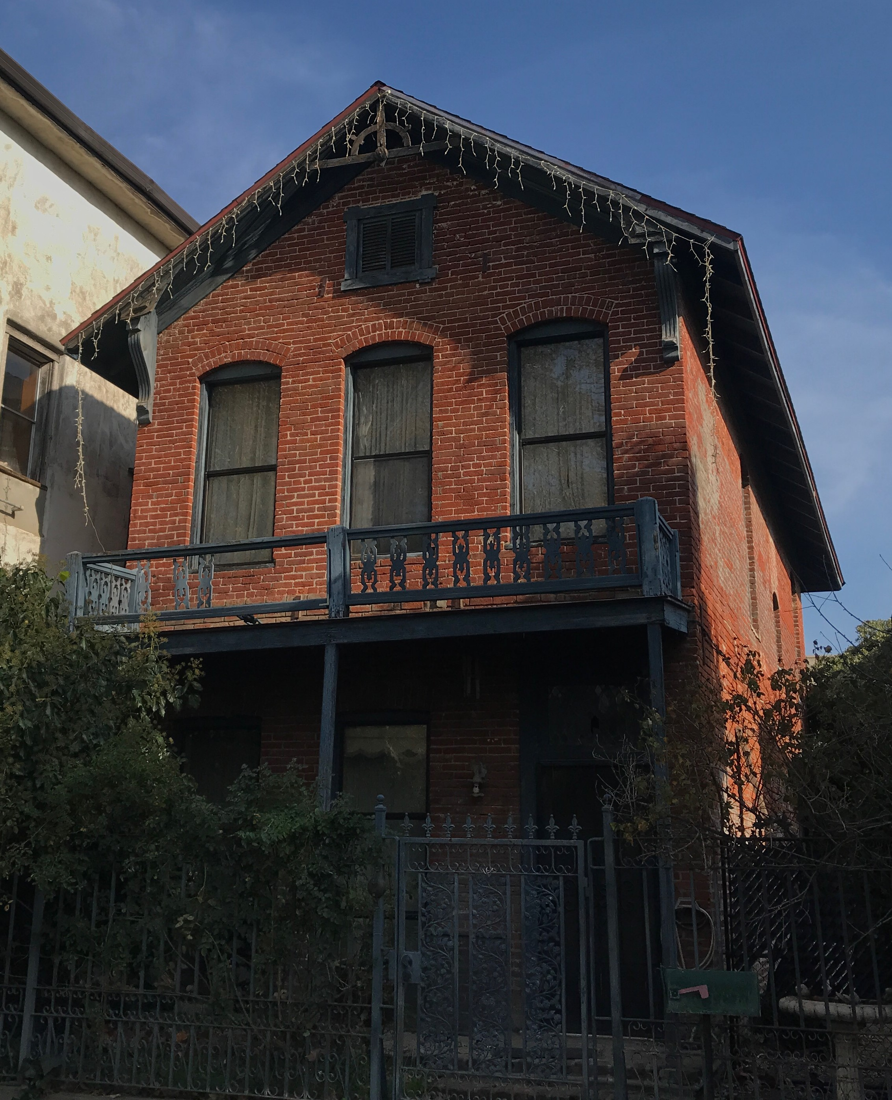
Draft + Final Specific Plan + Environmental Review
Draft Specific Plan
Draft General Plan/Specific Plan EIR
Planning Commission Workshop
Final Specific Plan
Final EIR
Planning Commission Recommendation
City Council Action
Notes:
Draft Specific Plan – reviewed by the City community development team
Revised draft Specific Plan – 2 public workshops for public, stakeholder, agency, and decision maker input
Final Specific Plan
Environmental review for the Specific Plan will take the form of subsections of the General Plan EIR
Environmental review will be structured to provide streaming capacity for future develops
Assume workshops and hearings on the Specific Plan will be consolidated with those required for environmental review

Slide 21
Discussion

Slide 22
Discussion
What are the most important planning issues for this planning process? Related to:
Land use
Transportation
Community design
Open space
Public facilities and infrastructure
The natural environment
Economic development and fiscal sustainability
Housing
What are some critical barriers to development and opportunities we must seize?
What are the most valuable community assets?
Who should we engage in particular?

Slide 23
Next
Vision + Guiding Principles
Alternatives
Draft Plans
Thank you!
Matthew Gerken
AECOM, Project Manager
matthew.gerken@aecom.com

